Slide 1


Write LESS CSS and make it SASSier
Jake Adams
Thompson Coburn LLP

Slide 2







































Platinum Sponsors
Gold Sponsors
Silver Sponsors

Slide 3
About Me
Jake Adams
Senior Programmer Analyst
Thompson Coburn LLP
email: jacobladams@gmail.com
twitter: @jacobladams
geekswithblogs.com/jacobladams
github.com/jacobladams
Speakerrate.com/jacobladams

Slide 4
Overview
What
Why
SASS and LESS Setup
Variables
Mixins
Functions
Etc.
Advanced
Links

Slide 5
What are SASS and LESS?
“CSS extension”
“CSS preprocessors”
“Higher-level CSS languages”
“CSS frameworks”

Slide 6

What are SASS and LESS
SASS
CSS
$blue: #3bbfce;
$margin: 16px;
.content-navigation {
border-color: $blue;
color:
darken($blue, 9%);
}
.border {
padding: $margin / 2;
margin: $margin / 2;
border-color: $blue;
}
.content-navigation {
border-color: #3bbfce;
color: #2b9eab;
}
.border {
padding: 8px;
margin: 8px;
border-color: #3bbfce;
}

Slide 7
Why?
DRY Principle
D on’t
R epeat
Y ourself

Slide 8
Don’t Repeat Yourself
public Stats GetStatsDatabase()
{
Stats stats = new Stats();
using (SqlConnection conn = new SqlConnection("Data Source=mySvr;Initial Catalog=myDB;User ID=jake;Password=password"))
{
using (SqlCommand command = new SqlCommand("GetNumberOfAccounts", conn))
{
command.CommandType = CommandType.StoredProcedure;
conn.Open();
stats.NumberOfAccounts = (int)command.ExecuteScalar();
}
}
using (SqlConnection conn = new SqlConnection("Data Source=mySvr;Initial Catalog=myDB;User ID=jake;Password=password"))
{
using (SqlCommand command = new SqlCommand("GetNumberOfClients", conn))
{
command.CommandType = CommandType.StoredProcedure;
conn.Open();
stats.NumberOfClients = (int)command.ExecuteScalar();
}
}
using (SqlConnection conn = new SqlConnection("Data Source=mySvr;Initial Catalog=myDB;User ID=jake;Password=password"))
{
using (SqlCommand command = new SqlCommand("GetNumberOfEmployees", conn))
{
command.CommandType = CommandType.StoredProcedure;
conn.Open();
stats.NumberOfEmployees = (int)command.ExecuteScalar();
}
}
return stats;
}

Slide 9
Don’t Repeat Yourself
private string _connectionString = "Data Source=mySvr;Initial Catalog=myDB;User ID=jake;Password=password";
public Stats GetStatsDatabase()
{
Stats stats = new Stats();
stats.NumberOfAccounts = (int)GetDataFromStoredProcedure("GetNumberOfAccounts");
stats.NumberOfClients = (int)GetDataFromStoredProcedure("GetNumberOfClients");
stats.NumberOfEmployees = (int)GetDataFromStoredProcedure("GetNumberOfEmployees");
return stats;
}
private object GetDataFromStoredProcedure(string storedProcedure)
{
using (SqlConnection conn = new SqlConnection(_connectionString))
{
using (SqlCommand command = new SqlCommand(storedProcedure, conn))
{
command.CommandType = CommandType.StoredProcedure;
conn.Open();
return command.ExecuteScalar();
}
}
}

Slide 10
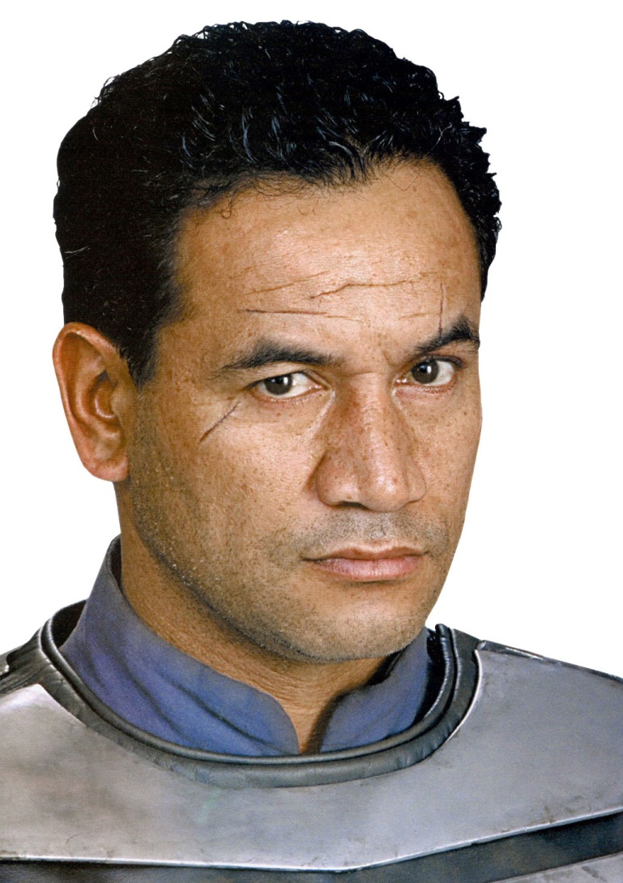
Don’t Repeat Yourself
Reduce Typing
Improve Maintainability
Reduce Errors

Slide 11

Make the machines work for you, not vice versa…

Slide 12
How?
Install Tools
Usage
1) Command line - one time compile
2) Command line - watch file/folder
3) Dynamic compile/Plugin

Slide 13
Precompile vs. Dynamic Compilation
Precompile
Dynamic Compilation

Slide 14


Install SASS
SASS in written in Ruby
1) Install Ruby via Ruby Windows Installer
2) From command line
gem install sass
s
1) Install IronRuby
2) From command line (as administrator)
igem install sass

Slide 15
SASS Command Line Usage
One time compile
sass myStyleSheet.scss myStyleSheet.css
Watch file
sass --watch myStyleSheet.scss:myStyleSheet.css
Watch directory of Sass files
sass --watch app/sass:public/stylesheets

Slide 16

LESS
LESS is primarily written in JavaScript
1) Download less.js and include it along with .less file in HTML
2) JavaScript will run when page is accessed and .less will be compiled and applied at runtime.
<link rel="stylesheet/less" type="text/css" href="myStyleSheet.less">
<script src="less.js" type="text/javascript"></script>

Slide 17

LESS
1) Install node.js for windows
2) From command line
npm install less
Command line usage
lessc myStyleSheet.less myStyleSheet.css

Slide 18

LESS
1) Download dotless
Command line - one time compile
dotless.Compiler.exe myStyleSheet.less [myStyleSheet.css]
Command line - watch file
dotless.Compiler.exe --watch myStyleSheet.less [myStyleSheet.css]

Slide 19
Variables
SASS
CSS
$pageWidth: 630px;
$headerHeight: 387px;
$mainGray: #999999;
$border: 0px dotted $mainGray;
$bgRepeat: no-repeat;
#container {
width: $pageWidth;
margin: auto;
background:url(rounded.jpg) $bgRepeat;
border: $border;
position: relative;
}
#pageHeader {
background: url(header.jpg) $bgRepeat;
border: $border;
width: $pageWidth;
height: $headerHeight;
}
#container {
width: 630px;
margin: auto;
background: url(rounded.jpg) no-repeat;
border: 0px dotted #999999;
position: relative; }
#pageHeader {
background: url(header.jpg) no-repeat;
border: 0px dotted #999999;
width: 630px;
height: 387px; }

Slide 20
Variables
SASS
LESS
$pageWidth: 630px;
$headerHeight: 387px;
$mainGray: #999999;
$border: 0px dotted $mainGray;
$bgRepeat: no-repeat;
#container {
width: $pageWidth;
margin: auto;
background:url(rounded.jpg) $bgRepeat;
border: $border;
position: relative;
}
#pageHeader {
background: url(header.jpg) $bgRepeat;
border: $border;
width: $pageWidth;
height: $headerHeight;
}
@pageWidth: 630px;
@headerHeight: 387px;
@mainGray: #999999;
@border: 0px dotted @mainGray;
@bgRepeat: no-repeat;
#container {
width: @pageWidth;
margin: auto;
background:url(rounded.jpg) @bgRepeat;
border: @border;
position: relative;
}
#pageHeader {
background: url(header.jpg) @bgRepeat;
border: @border;
width: @pageWidth;
height: @headerHeight;
}

Slide 21

Variable Scoping
SASS
LESS
$color: #000000;
.scoped {
$color: #ffffff;
color: $color;
}
.unscoped {
color: $color;
}
.scoped {
color: #ffffff; }
.unscoped {
color: #ffffff; }
@color: #000000;
.scoped {
@color: #ffffff;
color: @color;
}
.unscoped {
color: @color;
}
.scoped {
color: #ffffff;}
.unscoped {
color: #000000;}

Slide 22
Mixins
LESS
CSS
.annoyingFont{
font: bold 20px 'Comic Sans MS';
text-transform:uppercase;
text-decoration:underline
}
#footer{
.annoyingFont;
text-align:left;
padding:0 0 0 0;
margin:0 0 0 60px;
}
#pageHeader{
.annoyingFont;
width:630px;
height:387px;
}
.annoyingFont {
font: bold 20px 'Comic Sans MS';
text-transform: uppercase;
text-decoration: underline;
}
#footer {
font: bold 20px 'Comic Sans MS';
text-transform: uppercase;
text-decoration: underline;
text-align: left;
padding: 0 0 0 0;
margin: 0 0 0 60px;
}
#pageHeader {
font: bold 20px 'Comic Sans MS';
text-transform: uppercase;
text-decoration: underline;
width: 630px;
height: 387px;
}

Slide 23
Mixins
SASS
CSS
@mixin annoyingFont{
font: bold 20px 'Comic Sans MS';
text-transform:uppercase;
text-decoration:underline
}
#footer{
@include annoyingFont;
text-align:left;
padding:0 0 0 0;
margin:0 0 0 60px;
}
#pageHeader{
@include annoyingFont;
width:630px;
height:387px;
}
#footer {
font: bold 20px 'Comic Sans MS';
text-transform: uppercase;
text-decoration: underline;
text-align: left;
padding: 0 0 0 0;
margin: 0 0 0 60px;
}
#pageHeader {
font: bold 20px 'Comic Sans MS';
text-transform: uppercase;
text-decoration: underline;
width: 630px;
height: 387px;
}

Slide 24
Mixins – CSS3 and Vendor Prefixes

Slide 25
Parametric Mixins

Slide 26
Selector Inheritence

Slide 27
Nesting
CSS
SASS/LESS
#linkList {
position: absolute;
left:160px;
right:auto;
padding:0 0 0 0;
border:0px dotted #666666;
}
#linkList ul {
text-align: left;
list-style: none;
margin: 0 0 0 0;
padding:0 0 15px 35px;
border:0px dotted #666666;
width:120px;
}
#linkList ul li{
margin: 0;
padding: 3px 0 3px 0;
border-bottom: 1px dotted #999999;
}
#linkList ul li a{
border-bottom: none;
}
#linkList {
position: absolute;
left:160px;
right:auto;
padding:0 0 0 0;
border:0px dotted #666666;
ul {
text-align: left;
list-style: none;
margin: 0 0 0 0;
padding:0 0 15px 35px;
border:0px dotted #666666;
width:120px;
li{
margin: 0;
padding: 3px 0 3px 0;
border-bottom: 1px dotted #999999;
a{
border-bottom: none;
}
}
}
}

Slide 28

Operations
SASS
CSS
$containerWidth: 960px;
$pageWidth: $containerWidth *2/3;
#container{
width:$containerWidth;
}
#page{
width:$pageWidth;
}
#sidebar{
width:$containerWidth - $pageWidth;
}
#container {
width: 960px;
}
#page {
width: 640px;
}
#sidebar {
width: 320px;
}

Slide 29
Functions
SASS Functions
rgb
rgba

Slide 30
Comments

Slide 31
Imports

Slide 32
String Interpolation?

Slide 33
Differences

Slide 34
Advanced Features

Slide 35
Minify and other command line options

Slide 36
Conditional and control structure – sass only

Slide 37
LESS javascript watch option

Slide 38
Links
Ruby Installer
SassAndCoffee
Sass
Less

Slide 39
Contact

